Slide 2
Financial Priorities
Greg Mellow
29/08/2021
Jesus encounters Mary in JOHN 12:1-11

Slide 3
FINANICIAL PRIORITIES
Back story:
John 10 In Jerusalem Jesus was nearly killed or arrested. He left Jerusalem.
John 11 Jesus returned to Bethany, near Jerusalem, and raised Lazarus from the dead. There was a plot to kill Jesus.
Jesus went to Ephraim (Taybeh) 15Km to the north east of Jerusalem
Return to Bethany Al-Eizariya
JOHN 12:1-11

Slide 4
FINANICIAL PRIORITIES
Back story:
1. John 10: Jerusalem, attempt to kill & arrest Jesus
2. ‘beyond the Jordan’, 30+ Km east of Jerusalem
3. John 11: Bethany (Al-Eizariya), 3.2 Km, plot to kill him
4. Ephraim (Taybeh) 15 Km NE of Jerusalem
Edict to report Jesus, for arrest at Passover Feast
5. John 12: Jesus return to Bethany, 3.2Km.
JOHN 12:1-11

Slide 5
FINANICIAL PRIORITIES
The Scene:
1. Dinner with friends, Martha, Lazarus, Mary
2. Mary anoints Jesus feet with 325g of essence of nard
3. Judas complains
4. Jesus defends her, his death is immanent
5. (Plot to kill Lazarus too)
JOHN 12:1-11

Slide 6
FINANICIAL PRIORITIES
Lazarus’ Story Line | Jesus’ Story Line
Sick - immanent death | Danger – immanent death
Jesus waits | Jesus seems resigned / undeterred
Dies – four days in the tomb | Dies – three days in the tomb
Grieving / Complaints | Disciples distraught ???
Stone rolled away, grave clothes | Stone rolled away, grave clothes
Resurrection | Resurrection
JOHN 12:1-11

Slide 7
FINANICIAL PRIORITIES
The Scene:
1. Dinner with friends, Martha, Lazarus, Mary
2. Mary anoints Jesus feet with 325g of essence of nard
3. Judas complains
4. Jesus defends her, his death is immanent
5. (Plot to kill Lazarus too)
JOHN 12:1-11

Slide 8
FINANCIAL PRIORITIES
Nard, Spikenard
Himalaya,
Perfume, Wine spice
JOHN 12:1-11

Slide 9
FINANCIAL PRIORITIES
1-octacosanol, waxy, found in gum leaves
Ursolic acid, waxy, found in apple skin
Oleanolic acid, aromatic, in olive oil, tea tree oil
Beta-sitosterol, waxy, in nuts and avocado
JOHN 12:1-11

Slide 10
FINANCIAL PRIORITIES
Beta-sitosterol, waxy powder found in spike nard, nuts and avocado. Has a characteristic odour.
JOHN 12:1-11

Slide 11
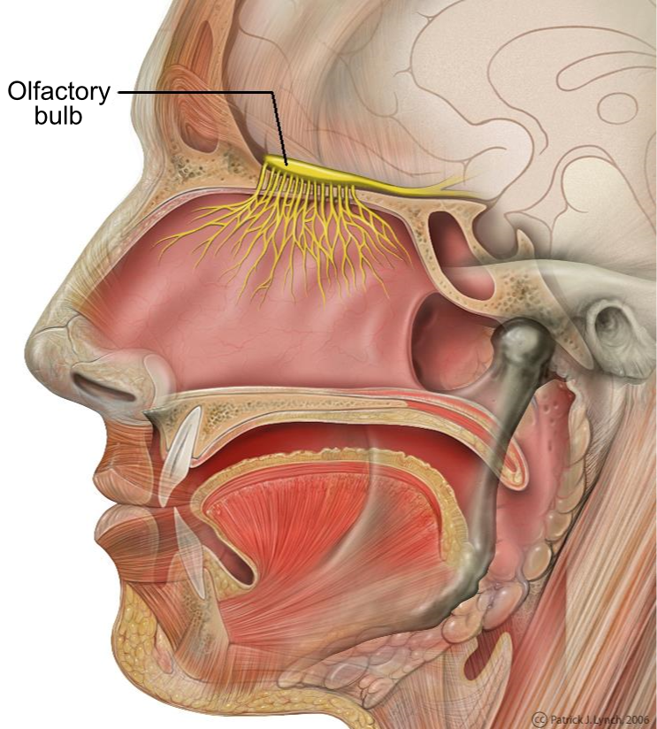
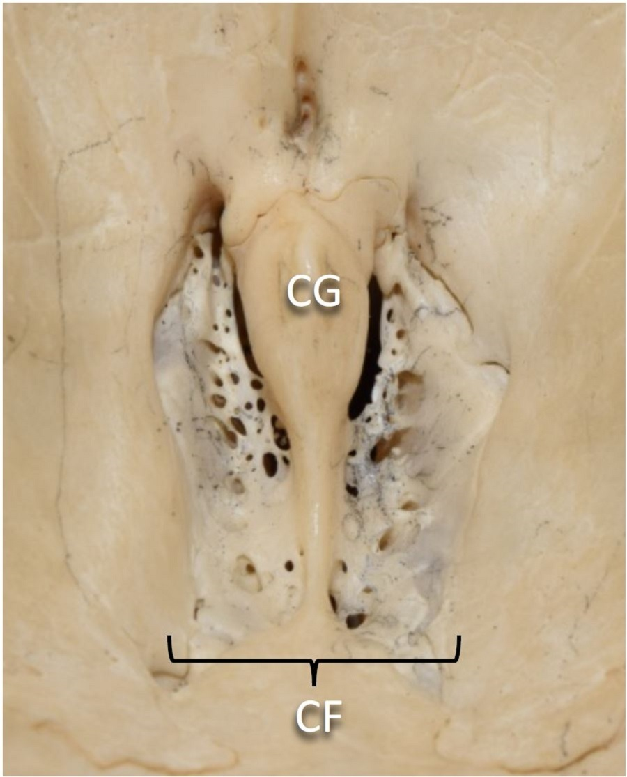
FINANCIAL PRIORITIES
JOHN 12:1-11

Slide 12
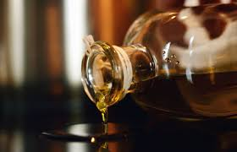
FINANCIAL PRIORITIES
JOHN 12:1-11

Slide 13
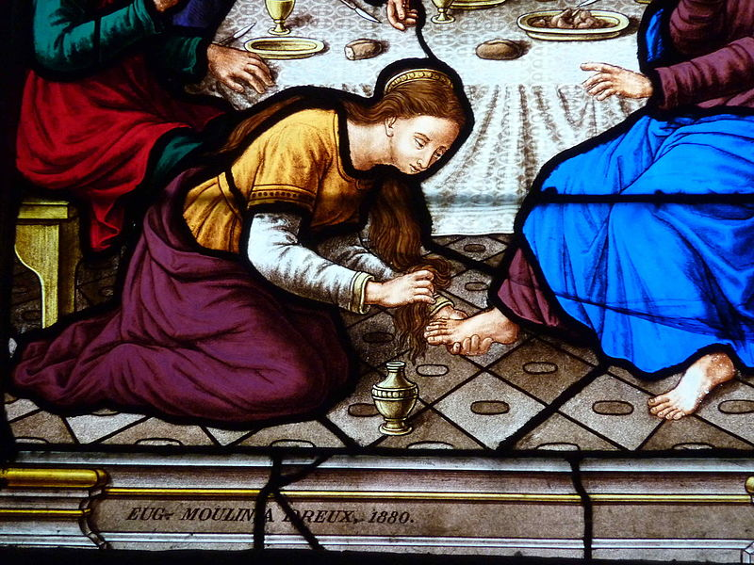
FINANCIAL PRIORITIES
JOHN 12:1-11

Slide 14
FINANICIAL PRIORITIES
The Conflict:
Mary
- makes a powerful statement, emotionally ‘present’,
- faces reality: Jesus’ immanent death, responds
JOHN 12:1-11

Slide 15
FINANICIAL PRIORITIES
The Conflict:
Mary
- makes a powerful statement, emotionally ‘present’,
- faces reality: Jesus’ immanent death, responds, generously
Judas
- ‘ethical’, but judging, complaining,
- inappropriate focus on money, grasping
JOHN 12:1-11

Slide 16
FINANICIAL PRIORITIES
So we learn from Mary:
- be brave, face up to reality, respond
- leave room for generosity
- be an emotionally connected ‘human’
- Be connected to Jesus
Jesus’ death, and resurrection, are central.
JOHN 12:1-11

Slide 19
FINANCIAL PRIORITIES
JOHN 12:1-11

Slide 20
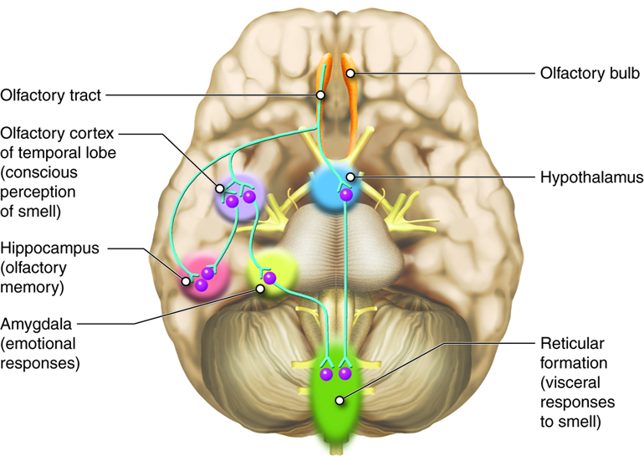
FINANCIAL PRIORITIES
JOHN 12:1-11

